Slide 1
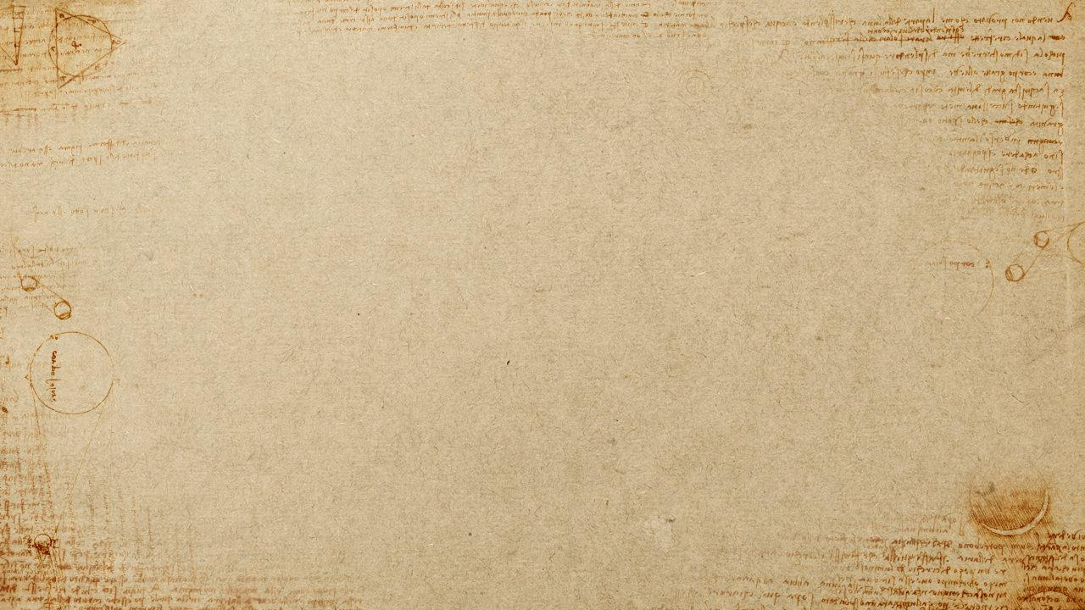
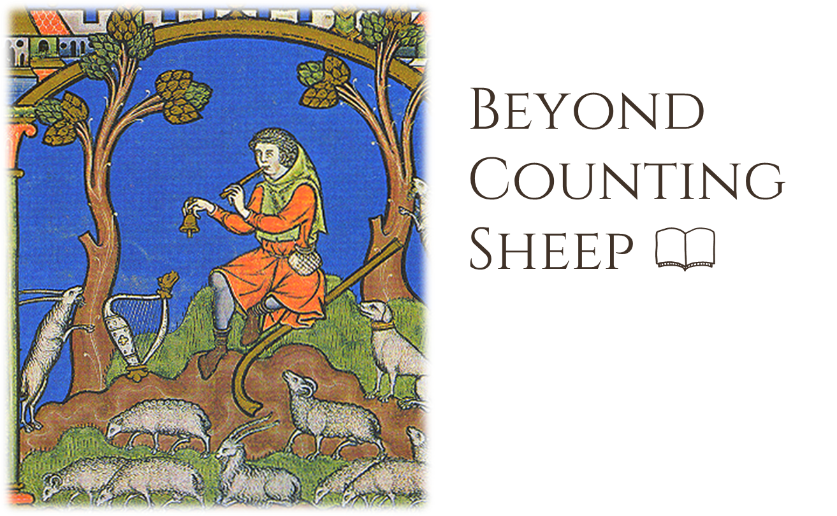

Roxanne Guildford
PhD candidate in Archaeology
University of Edinburgh

Slide 2
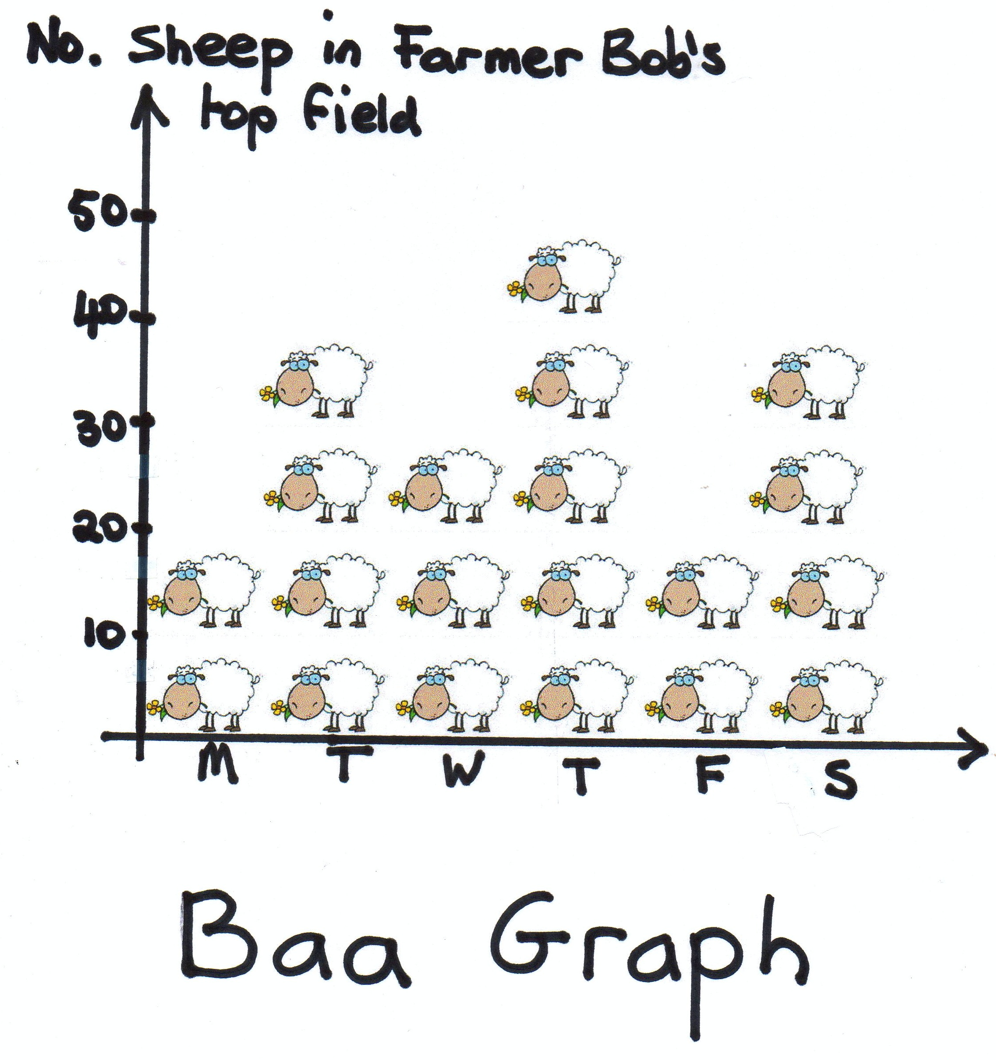
Why Count Sheep?
Cultural and economic shifts in land management
Change in pastoral husbandry strategies across time
Change in relationships between flock, farmer, and economic values
Notes:
Exploring the relative ratio of sheep to other domesticated species in the archaeological record (aka taxonomic abundance) may show patterns in the data that help to explain:
Cultural and economic shifts in land management
Change in pastoral husbandry strategies across time
Change in relationships between flock, farmer, and economic values

Slide 3
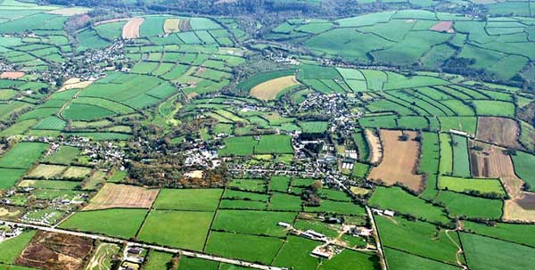

Slide 4
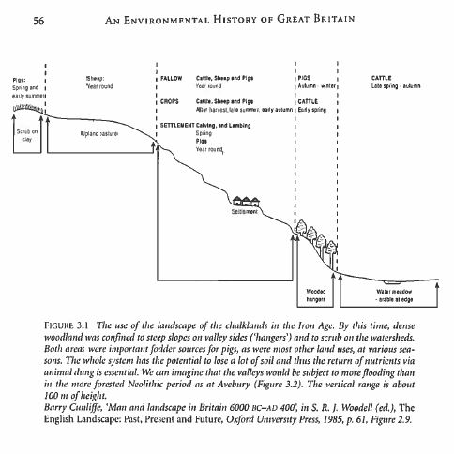
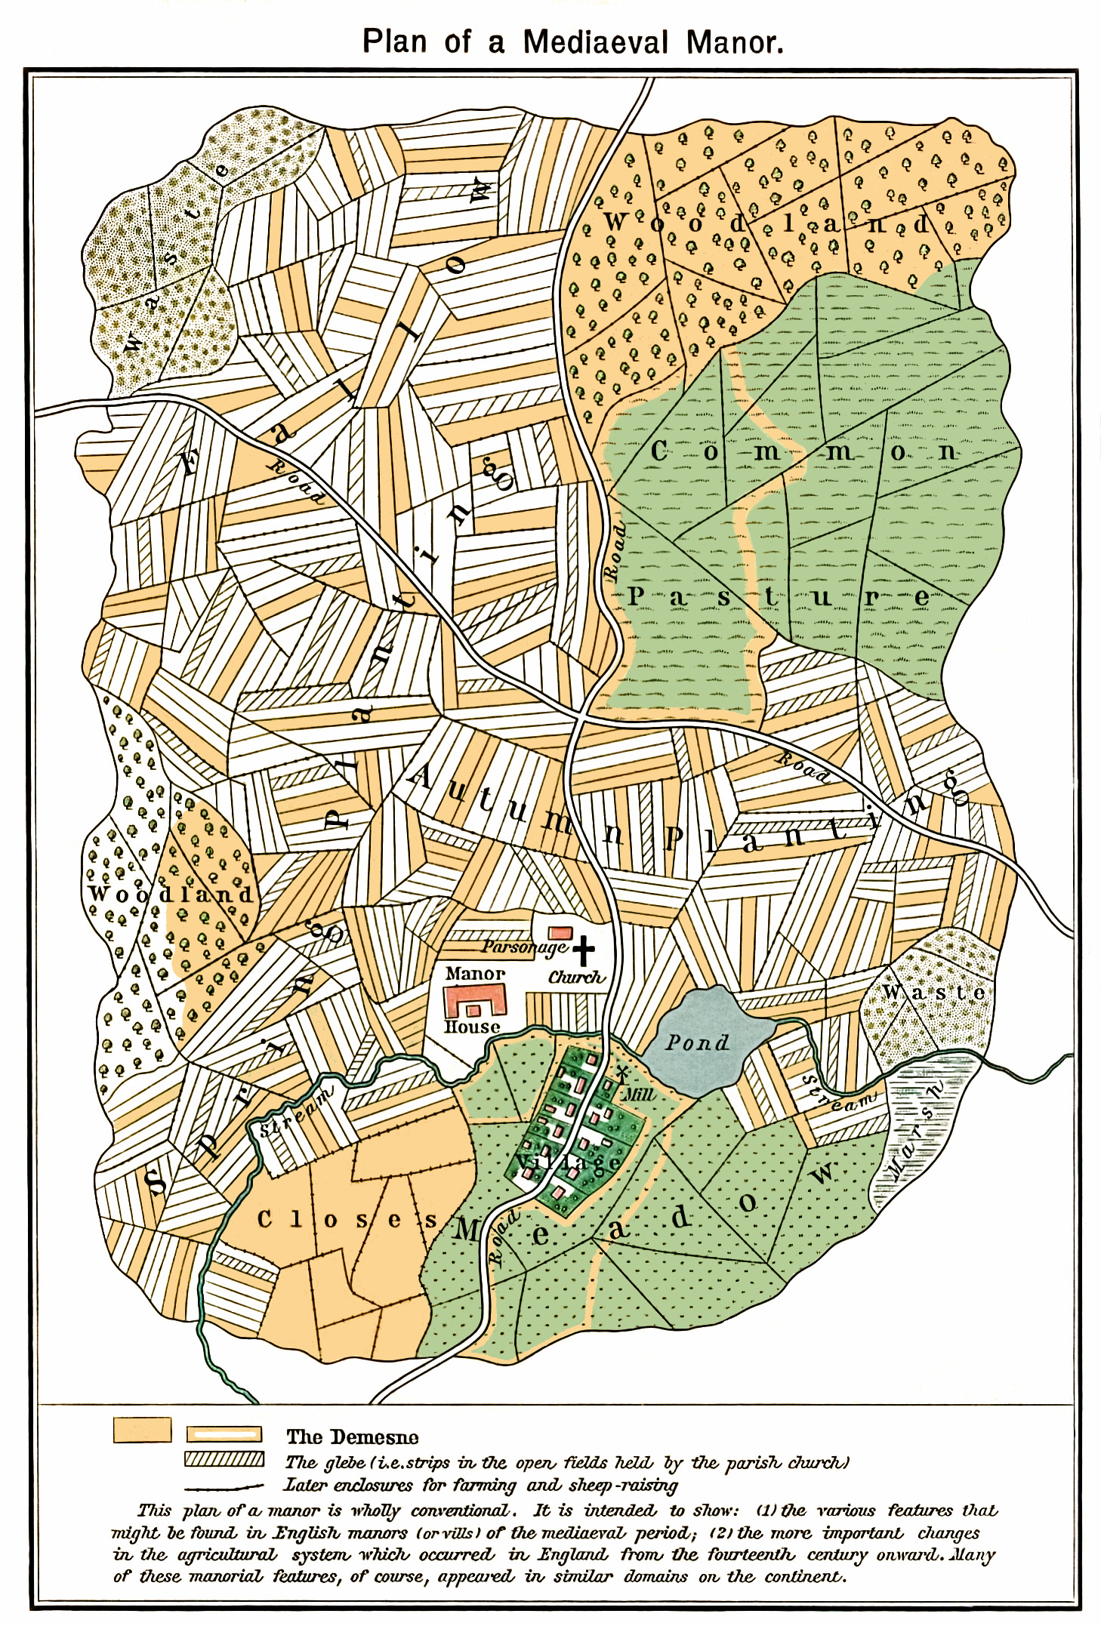
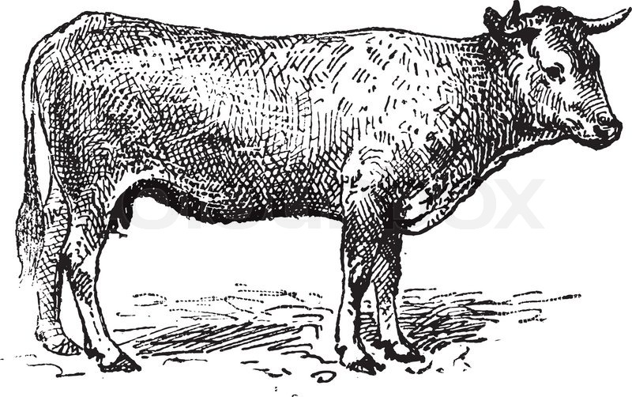
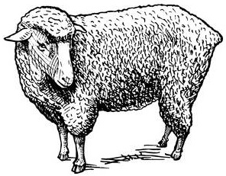
Notes:
Beginning of intensive use of marginal landscapes for pastoral farming = separation of species over different elevations and differing ecological regions
Movement of sheep to pastures that do not have sufficient water sources for cattle or arable farming; transhumance between upland elevations during summer months and sheltering near settlements during the winter (Martinmas to Easter)
Dominance of sheep across ecological landscapes: transition of arable lands to pasture, chalkland flocks, continued reduction of forests, limited boundaries by enclosure

Slide 5
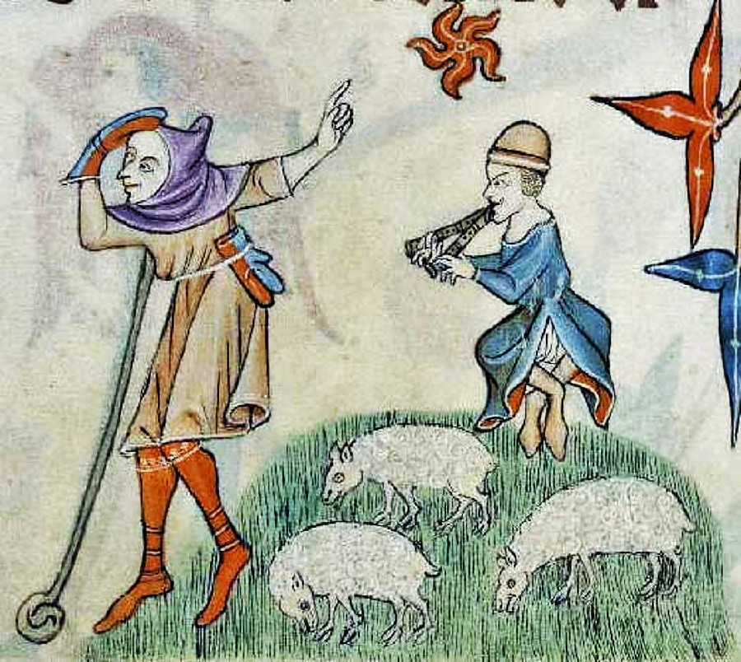
Changes in Medieval Pastoral Farming
Intensified management of sheep
Shift to cash-driven strategies
Re-organization of field systems
Notes:
Increased caring for sheep: greater investment = greater financial return
Change to cash-driven strategies: management of health influenced by marked demands rather than humanitarian concerns
Re-structuring of the human landscape: institution of sheepcotes, change in transhumance practice, movement from arable land to pasture, eventual enclosure and privatization of pastureland

Slide 6
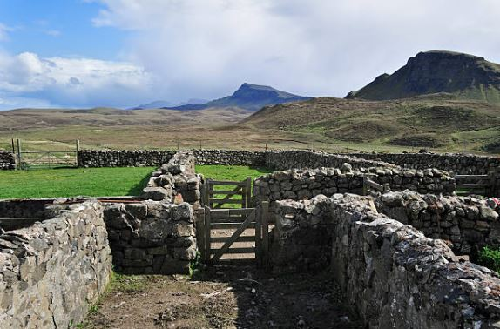

Slide 7
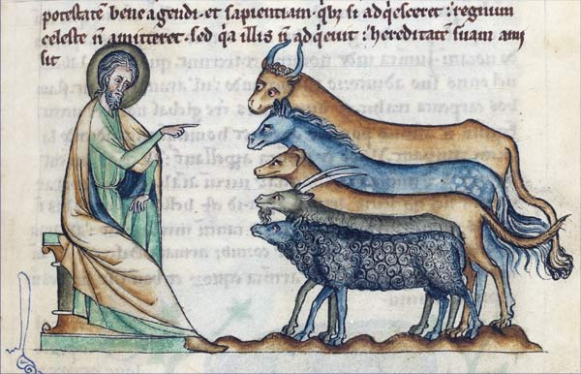
Challenges in Medieval Archaeology and the Faunal Record

Slide 8
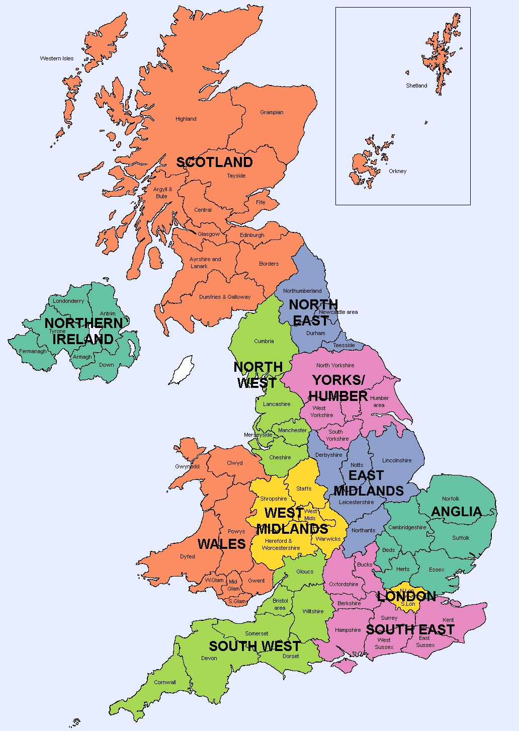
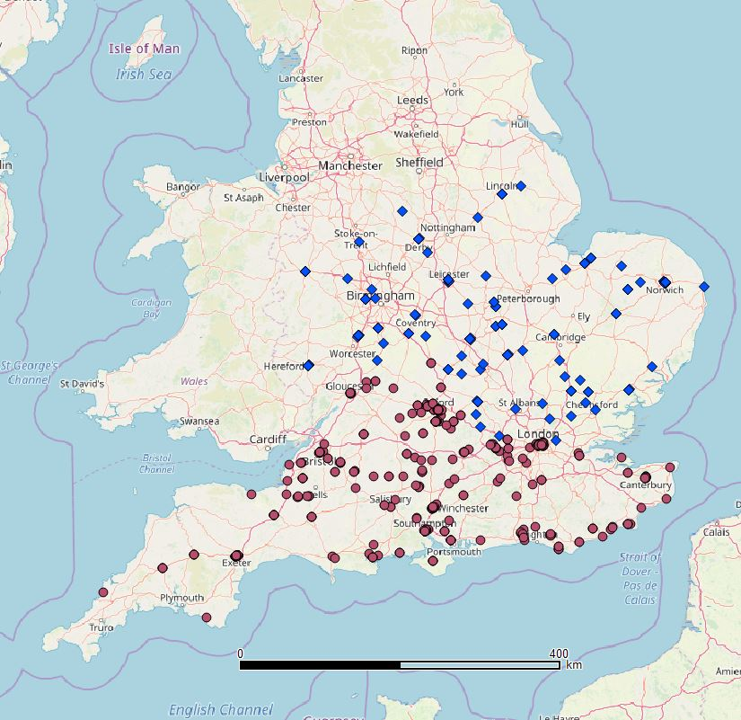
Notes:
A Review of Animal Bone Evidence from Central England by Umberto Albarella, Tessa Pirnie, 2008
A Review of Animal Bone Evidence from the Saxon to Post Medieval Periods in Southern Britain by Matilda Holmes, 2018
Comparative data from individual Roman, Anglo-Saxon, and Medieval assemblages

Slide 9
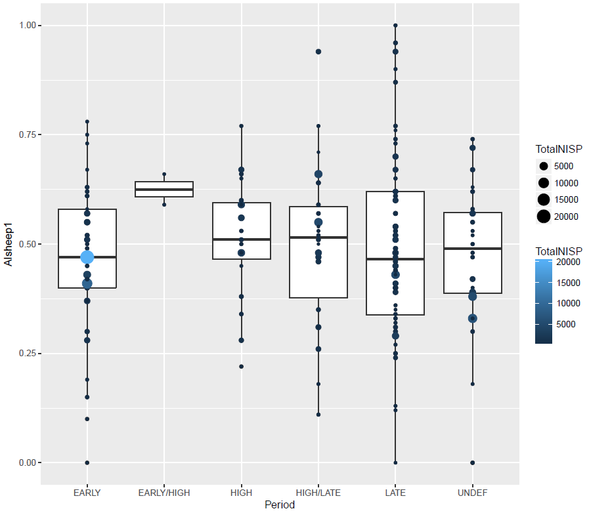
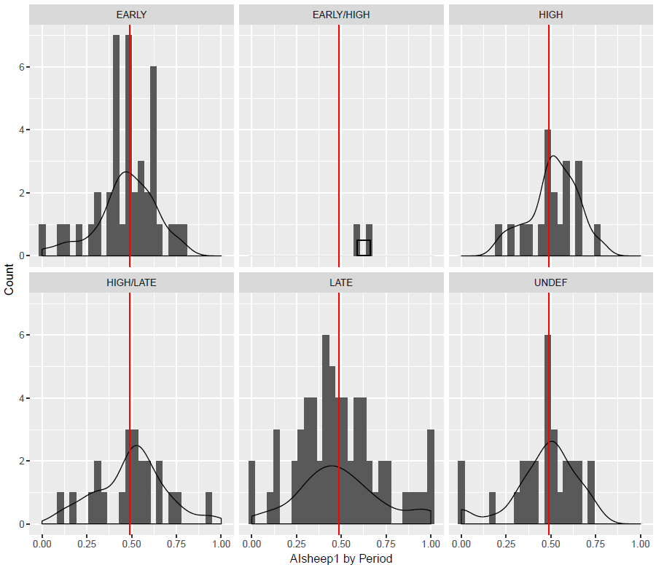
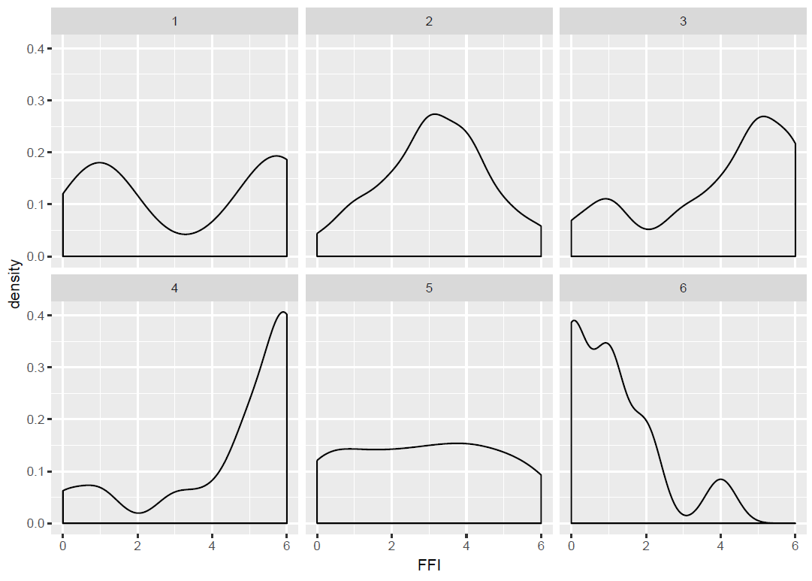
Notes:
Density of entire data set appears somewhat normally distributed
Presence of possible outliers at opposite ends of the range
NISPsheep = 1.00
NISPcattle = 0.00
Most sites fall between 0.25 and 0.75 index
Mean calculated at 0.4873
Variance = 0.0389
Standard deviation = 0.1972
Very different picture of distribution as separated by Period
Late Period is not normally distributed:
Central peak is further away from the mean
Clumping of values at or near
1.00 and 0.00
Lean towards dominance in cattle ratio with greater number of sites with only cattle or sheep remains
Early-High and Undefined not useful for statistical analysis, subsequently removed from the study
Differences in the spread of the data and the range are apparent
Late Period stands out again as showing a more even distribution of data across the entire range
Early Period stands out as the largest assemblages are present, and clumped around the median
Largest assemblages are from Urban sites, as well as the largest number of observations

Slide 10
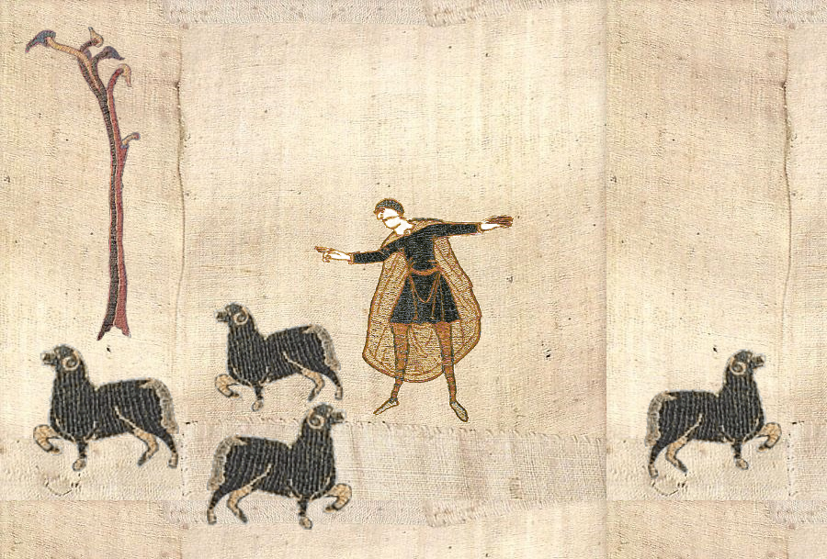
Roxanne Guildford
roxanne.guildford@ed.ac.uk
https://github.com/rguildford

